Slide 1
Serializability, Conflict Serializability, View Serializability and Recoverability
Department of Computer Science and Engineering,
Chitkara University, Himachal Pradesh

Slide 2
Serializability
Basic Assumption – Each transaction preserves database consistency.
Thus serial execution of a set of transactions preserves database consistency.
A (possibly concurrent) schedule is serializable if it is equivalent to a serial schedule.
A transaction schedule is serializable if its outcome is equal to the outcome of its transactions executed serially i.e. sequentially without overlapping in time.
A serializable schedule always leaves the database in consistent state.
A serial schedule is always a serializable schedule because a new transaction only starts when the older one has finished execution.

Slide 3
Serializability
Different forms of schedule equivalence give rise to the notions of:
1. conflict serializability
2. view serializability
Operations other than read and write instructions are ignored
Transactions may perform arbitrary computations on data in local buffers in between reads and writes.
Simplified schedules consist of only read and write instructions.

Slide 4
Serializability
No. | Conflict Serializability | View Serializability
1. | Two schedules are said to be conflict equivalent if all the conflicting operations in both the schedule get executed in the same order. If a schedule is a conflict equivalent to its serial schedule then it is called Conflict Serializable Schedule. | Two schedules are said to be view equivalent if the order of initial read, final write and update operations is the same in both the schedules. If a schedule is view equivalent to its serial schedule then it is called View Serializable Schedule.
2. | If a schedule is view serializable then it may or may not be conflict serializable. | If a schedule is conflict serializable then it is also view serializable schedule.
3. | Conflict equivalence can be easily achieved by reordering the operations of two transactions therefore, Conflict Serializability is easy to achieve. | View equivalence is rather difficult to achieve as both transactions should perform similar actions in a similar manner. Thus, View Serializability is difficult to achieve.
4. | For a transaction T1 writing a value A that no one else reads but later some other transactions say T2 write its own value of A, W(A) cannot be placed under positions where it is never read. | If a transaction T1 writes a value A that no other transaction reads (because later some other transactions say T2 writes its own value of A) W(A) can be placed in positions of the schedule where it is never read.

Slide 5
Conflict Serializability
﻿Suppose schedule S in which there are two consecutive instructions, I and J , of transactions Ti and Tj, respectively (i ≠ j).
If I and J refer to different data items, then we can swap I and J without affecting the results of any instruction in the schedule.
However, if I and J refer to the same data item Q, then the order of the two steps may matter. Since we are dealing with only read and write instructions, there are four cases to consider:
There can be conflict if and only if there exists some item Q accessed by both l_{i} and l_{j}, and at least one of these instructions wrote Q.
1. l_{i} = read(Q), l_{j} = read(Q). l_{i} and l_{j} don’t conflict. 2. l_{i} = read(Q), l_{j} = write(Q). They conflict. 3. l_{i} = write(Q), l_{j} = read(Q). They conflict 4. l_{i} = write(Q), l_{j} = write(Q). They conflict
A conflict between l_{i} and l_{j} forces a (logical) temporal order between them. If l_{i} and l_{j} are consecutive in a schedule and they do not conflict, their results would remain the same even if they had been interchanged in the schedule.

Slide 6
Conflict Serializability
If a schedule S can be transformed into a schedule S´ by a series of swaps of non-conflicting instructions, S and S´ are conflict equivalent.
A schedule S is conflict serializable if it is conflict equivalent to a serial schedule
Example of a schedule that is not conflict serializable:
T₃ T₄ read(Q) write(Q) write(Q) It is unable to swap instructions in the above schedule to obtain either the serial schedule
< T₃, T₄ >, or the serial schedule < T₄, T₃ >.

Slide 7
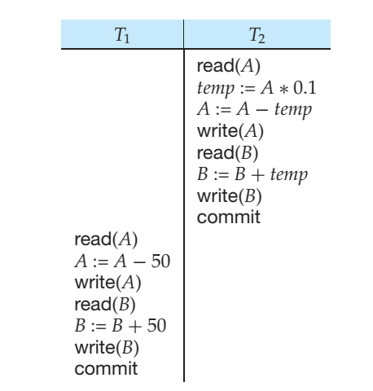
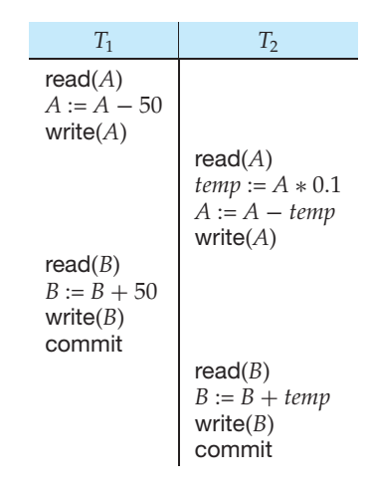
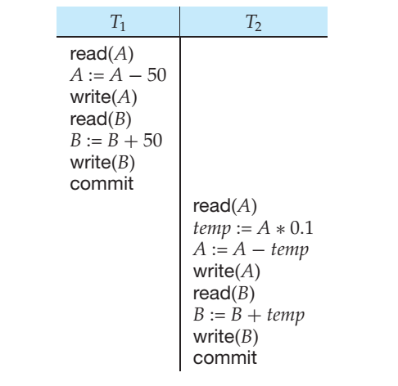
Conflict Serializability
Schedule 3 below can be transformed into Schedule 1, a serial schedule where T₂ follows T₁, by series of swaps of non-conflicting instructions.
Therefore Schedule 3 is conflict serializable.
Schedule 1 Schedule 2 Schedule 3

Slide 8
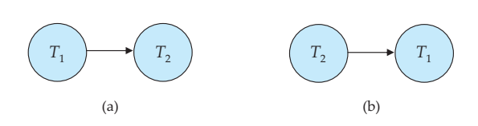
Conflict Serializability
Precedence Graph
Precedence Graph for (a) Schedule 1 (b) Schedule 2

Slide 9
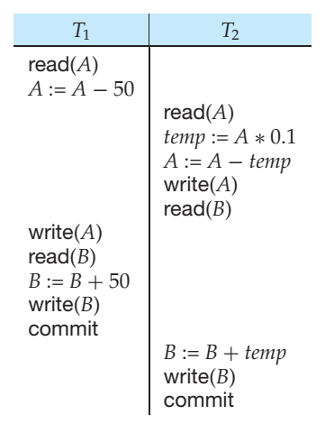
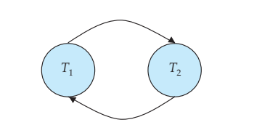
Conflict Serializability
Schedule 4
Precedence Graph for Schedule 4

Slide 10
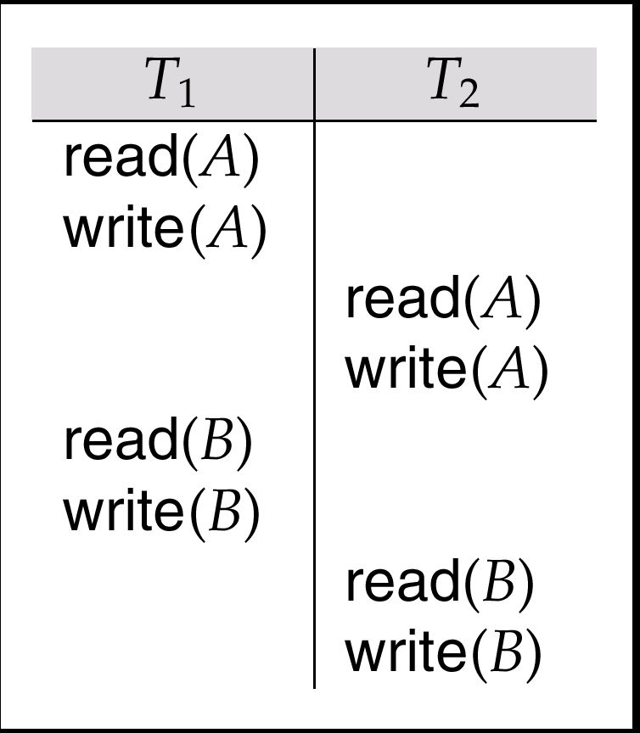
Conflict Serializability
Schedule 3 Showing only read and write instructions

Slide 11
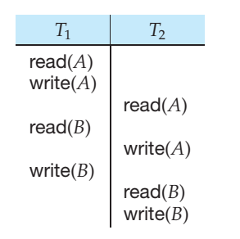
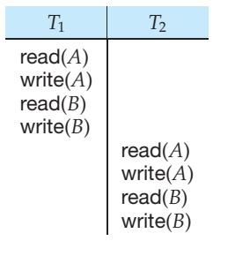
Conflict Serializability
Schedule 5 After swapping of a pair of instructions
Schedule 6 A Serial Schedule that is equivalent to Schedule 3

Slide 12
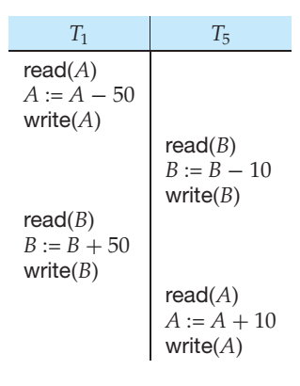
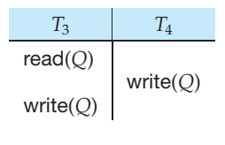
Conflict Serializability
Schedule 7
Schedule 8

Slide 13
View Serializability
Let S and S´ be two schedules with the same set of transactions. S and S´ are view equivalent if the following three conditions are met:
1. For each data item Q, if transaction T_{i} reads the initial value of Q in schedule S, then transaction T_{i} must, in schedule S´, also read the initial value of Q.
2. For each data item Q if transaction T_{i} executes read(Q) in schedule S, and that value was produced by transaction T_{j} (if any), then transaction T_{i} must in schedule S´ also read the value of Q that was produced by transaction T_{j} .
3. For each data item Q, the transaction (if any) that performs the final write(Q) operation in schedule S must perform the final write(Q) operation in schedule S´.
As can be seen, view equivalence is also based purely on reads and writes alone.

Slide 14
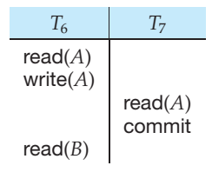
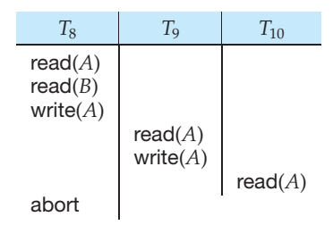
Conflict Serializability
Schedule 9, A Non Recoverable Schedule Schedule 10

Slide 15
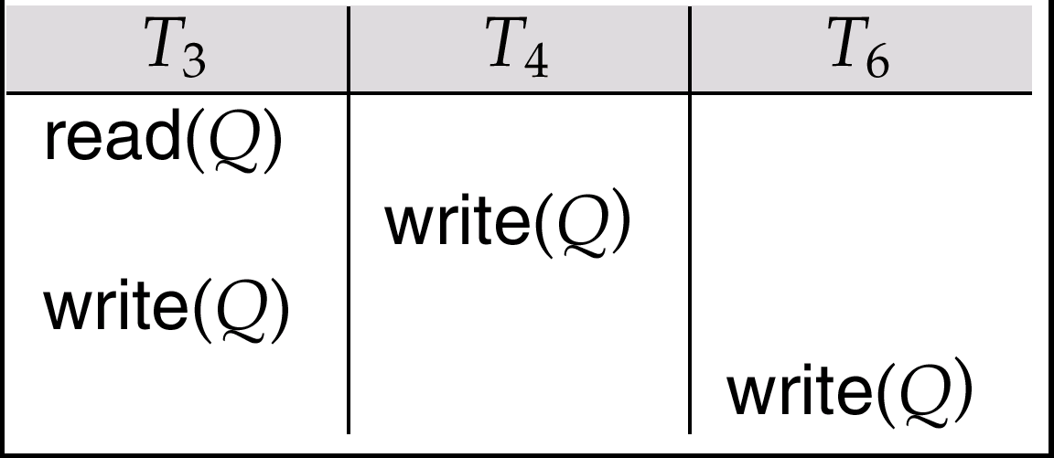
View Serializability
A schedule S is view serializable it is view equivalent to a serial schedule.
Every conflict serializable schedule is also view serializable.
Schedule 9 (from text) — a schedule which is view-serializable but not conflict serializable.
Every view serializable schedule that is not conflict serializable has blind writes.

Slide 16
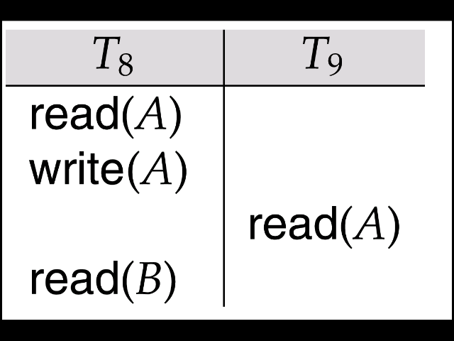
Recoverability
Need to address the effect of transaction failures on concurrently running transactions.
Recoverable schedule — if a transaction T_{j} reads a data items previously written by a transaction T_{i} , the commit operation of T_{i} appears before the commit operation of T_{j}.
The following schedule (Schedule 11) is not recoverable if T₉ commits immediately after the read
If T₈ should abort, T₉ would have read (and possibly shown to the user) an inconsistent database state. Hence database must ensure that schedules are recoverable.

Slide 17
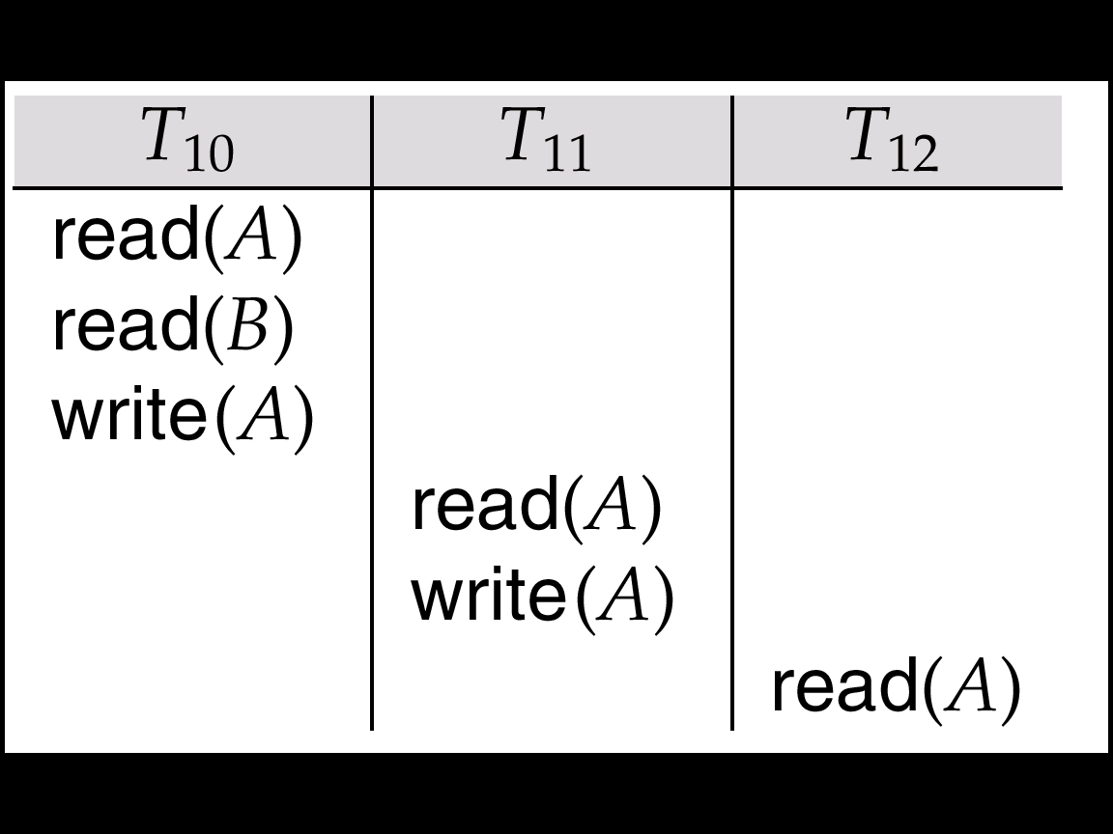
Recoverability
Cascading rollback – a single transaction failure leads to a series of transaction rollbacks. Consider the following schedule where none of the transactions has yet committed (so the schedule is recoverable)
If T₁₀ fails, T₁₁ and T₁₂ must also be rolled back.
Can lead to the undoing of a significant amount of work

Slide 18
Recoverability
Cascadeless schedules — cascading rollbacks cannot occur; for each pair of transactions T_{i} and T_{j} such that T_{j} reads a data item previously written by T_{i}, the commit operation of T_{i} appears before the read operation of T_{j}.
Every cascadeless schedule is also recoverable
It is desirable to restrict the schedules to those that are cascadeless

Slide 19
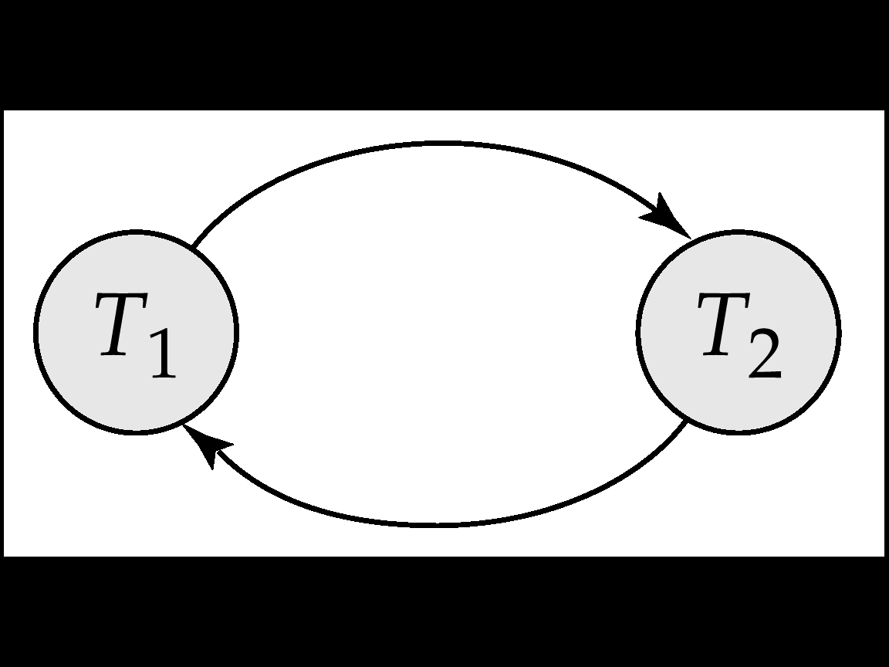
Testing for Serializability
Consider some schedule of a set of transactions T₁, T₂, ..., T_{n}
Precedence graph — a direct graph where the vertices are the transactions (names).
An arc from T_{i} to T_{j} is drawn if the two transaction conflict, and T_{i} accessed the data item on which the conflict arose earlier.
The arc may be labelled by the item that was accessed.
Example 1
X
Y

Slide 20
Example Schedule (Schedule A)
T1
T2
T3
T4
T5
Read (X)
Read (Y)
Read (Z)
Read (V)
Read (W)
Read (W)
Read (Y)
Write (Y)
Write (Z)
Read (U)
Read (Y)
Write (Y)
Read (Z)
Write (Z)
Read (U)
Write (U)

Slide 21
Test for Conflict Serializability
A schedule is conflict serializable if and only if its precedence graph is acyclic.
Cycle-detection algorithms exist which take order n² time, where n is the number of vertices in the graph. (Better algorithms take order n + e where e is the number of edges.)
If precedence graph is acyclic, the serializability order can be obtained by a topological sorting of the graph. This is a linear order consistent with the partial order of the graph. For example, a serializability order for Schedule A would be T₅ → T₁ → T₃ → T₂ → T₄ .

Slide 22
Summary
Serializability: A (possibly concurrent) schedule is serializable if it is equivalent to a serial schedule
Conflict Serializability: A schedule is conflict serializable if it is conflict equivalent to a serial schedule
View Serializability: A schedule S is view serializable it is view equivalent to a serial schedule. Every conflict serializable schedule is also view serializable.
Recoverability: Schedules in which transactions commit only after all transactions whose changes they read commit are called recoverable schedules.
Precedence Graph: Also called Serialization Graph is used commonly to test Conflict Serializability of a schedule.
It is a directed Graph (V, E) consisting of a set of nodes V = {T₁, T₂, T₃……….T_{n}} and a set of directed edges E = {e₁, e₂, e₃………………e_{m}}.

Slide 23
Thank You

